Slide 1
Content
Dynamic programming review
Dynamic programming as a linear programming problem
Example (I): random walk problem (DP vs LP convergence)
Dual representation of the LP approach
Example (II): random walk problem (primal-dual comparison)
Future lines (09/03/2017)
DANIEL GARCÍA-OCAÑA HERNÁNDEZ

Slide 2
Content
DYNAMIC PROGRAMMING REVIEW
Dynamic programming as a linear programming problem
Example (I): random walk problem (DP vs LP convergence)
Dual representation of the LP approach
Example (II): random walk problem (primal-dual comparison)
Future lines (09/03/2017)

Slide 3

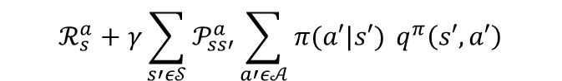
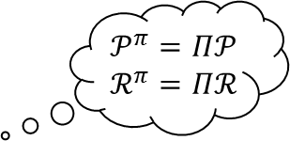
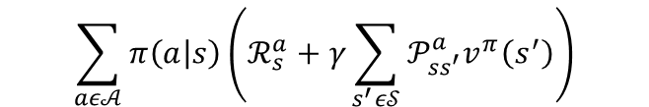
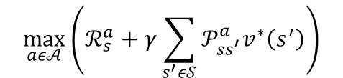


Bellman’s equations
$$𝒫^{π}=Π𝒫$$
$$ℛ^{π}=Πℛ$$
a
$v^{π}\left(s\right)=𝔼_{π,𝒫}\left[G_{t} | S_{t}=s, A_{t}\sim π\right]=𝔼_{π,𝒫}\left[R_{t+1}+γv^{π}(S_{t+1}) | S_{t}=s, A_{t+k}\sim π\right]=$
$$\sum_{aε𝒜}{π\left(a | s\right)\left(ℛ_{s}^{a}+γ\sum_{s^{′}ε𝒮}{𝒫_{ss^{′}}^{a}v^{π}\left(s^{′}\right)}\right)}$$
vector form
$$v^{π}=ℛ^{π}+γ𝒫^{π}v^{π}$$
$v^{∗}\left(s\right)=\max_{aε𝒜}{𝔼_{𝒫}\left[R_{t+1}+γv^{∗}(S_{t+1}) | S_{t}=s\right]}=$
$$\max_{aε𝒜}\left(ℛ_{s}^{a}+γ\sum_{s^{′}ε𝒮}{𝒫_{ss^{′}}^{a}v^{∗}\left(s^{′}\right)}\right)$$
$q^{π}\left(s,a\right)=𝔼_{π,𝒫}\left[G_{t} | S_{t}=s,A_{t}=a,A_{t+k}\sim π\right]=𝔼_{π,𝒫}\left[R_{t+1}+γq^{π}\left(S_{t+1},A_{t+1}\right) | S_{t}=s,A_{t}=a,A_{t+k}\sim π\right]=$
$$ℛ_{s}^{a}+γ\sum_{s′ε𝒮}{𝒫_{ss′}^{a}\sum_{a′ε𝒜}{π(a′|s′) }q^{π}\left(s′,a′\right)}$$
vector form
$$q^{π}=ℛ+γ𝒫Πq^{π}$$
$q^{∗}\left(s,a\right)=\max_{aε𝒜}{𝔼_{𝒫}\left[R_{t+1}+γq^{∗}(S_{t+1},A_{t+1}) | S_{t}=s,A_{t}=a\right]}=$
$$ℛ_{s}^{a}+γ\sum_{s′ε𝒮}{𝒫_{ss′}^{a}\max_{a′ε𝒜}{ q}^{∗}\left(s′,a′\right)}$$
Notes:
3.23, 24, 28 y 29
transition probability matrix and the expected reward vector for policy all possible deterministic policies (3.42 y 3.43)
La óptima sigue una greedy policy (3.56)

Slide 4


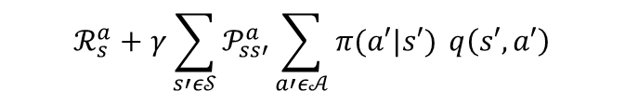
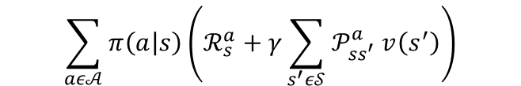

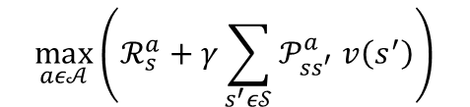


Bellman’s operator: definition
a
$\left(T_{π}v\right)\left(s\right)≜𝔼_{π,𝒫}\left[R_{t+1}+γv(S_{t+1}) | S_{t}=s, A_{t+k}\sim π\right]=$
$$\sum_{aε𝒜}{π\left(a | s\right)\left(ℛ_{s}^{a}+γ\sum_{s^{′}ε𝒮}{𝒫_{ss^{′}}^{a} v\left(s^{′}\right)}\right)}$$
vector form
$$T_{π}v$$
$(Tv)\left(s\right)≜\max_{aε𝒜}{𝔼_{𝒫}\left[R_{t+1}+γv(S_{t+1}) | S_{t}=s\right]}=$
$$\max_{aε𝒜}\left(ℛ_{s}^{a}+γ\sum_{s^{′}ε𝒮}{𝒫_{ss^{′}}^{a} v\left(s^{′}\right)}\right)$$
vector form
$$Tv$$
$\left(T_{π}q\right)\left(s,a\right)≜𝔼_{π,𝒫}\left[R_{t+1}+γq\left(S_{t+1},A_{t+1}\right) | S_{t}=s,A_{t}=a,A_{t+k}\sim π\right]=$
$$ℛ_{s}^{a}+γ\sum_{s′ε𝒮}{𝒫_{ss′}^{a}\sum_{a′ε𝒜}{π(a′|s′) }q\left(s′,a′\right)}$$
vector form
$$T_{π}q$$
$(Tq)\left(s,a\right)≜\max_{aε𝒜}{𝔼_{𝒫}\left[R_{t+1}+γq(S_{t+1},A_{t+1}) | S_{t}=s,A_{t}=a\right]}=$
$$ℛ_{s}^{a}+γ\sum_{s′ε𝒮}{𝒫_{ss′}^{a}\max_{a′ε𝒜} q\left(s′,a′\right)}$$
vector form
$$Tq$$
Notes:
Lío con la notación!!
A shorthand notation → notación taquigráfica
Mapping que transforma la función de v a S en una función de Tv a S (FUNCIONAL)

Slide 5
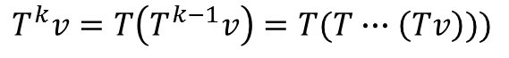
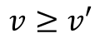
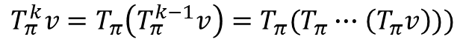
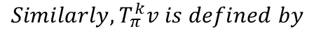
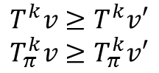
Bellman’s operator: some basic properties
Composition mapping
Monoticity
$$We will denote by T^{k} the composition of the mapping T with itself k times;i.e, for all k, we write$$
$$T^{k}v=T\left(T^{k−1}v\right)=T(T∙∙∙\left(Tv\right)))$$
$$Similarly, T_{π}^{k}v is defined by$$
$$T_{π}^{k}v=T_{π}\left(T_{π}^{k−1}v\right)=T_{π}(T_{π}∙∙∙\left(T_{π}v\right)))$$
$$For any function v:𝒮→ℝ and v^{′}:𝒮→ℝ such that$$
$$v≥v′$$
$$\left(let us write v≥v^{′} to denote that v\left(s\right)≥v^{′}\left(s\right) for all s ε 𝒮\right), we have$$
$$T^{k}v≥T^{k}v′$$
$$T_{π}^{k}v≥T_{π}^{k}v′$$

Slide 6
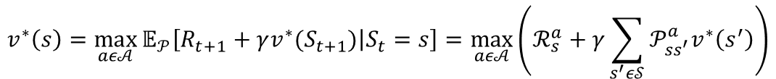
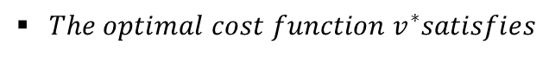


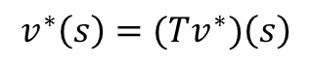
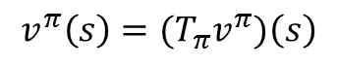
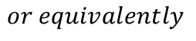
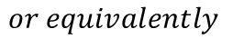
Bellman’s operator: towards Bellman’s equations
$The optimal cost function{ v}^{∗}satisfies$
a
$$v^{∗}\left(s\right)=\max_{aε𝒜}{𝔼_{𝒫}\left[R_{t+1}+γv^{∗}(S_{t+1}) | S_{t}=s\right]}=\max_{aε𝒜}\left(ℛ_{s}^{a}+γ\sum_{s^{′}ε𝒮}{𝒫_{ss^{′}}^{a}v^{∗}\left(s^{′}\right)}\right)$$
$or equivalently$
vector form
$$v^{∗}\left(s\right)=(Tv^{∗})\left(s\right)$$
$$v^{∗}=Tv^{∗}$$
$${ Furthermore, v}^{∗} is the unique solution of this equation within the class of bounded functions.$$
$For every stationary policy π, the associated cost function satisfies$
$$v^{π}\left(s\right)=𝔼_{π,𝒫}\left[R_{t+1}+γv^{π}(S_{t+1}) | S_{t}=s, A_{t+k}\sim π\right]=\sum_{aε𝒜}{π\left(a | s\right)\left(ℛ_{s}^{a}+γ\sum_{s^{′}ε𝒮}{𝒫_{ss^{′}}^{a}v^{π}\left(s^{′}\right)}\right)}$$
$or equivalently$
$$v^{π}\left(s\right)=(T_{π}v^{π})\left(s\right)$$
vector form
$$v^{π}=T_{π}v^{π}$$
$${ Furthermore, v}^{π} is the unique solution of this equation within the class of bounded functions.$$

Slide 7
Content
Dynamic programming review
DYNAMIC PROGRAMMING AS A LINEAR PROGRAMMING PROBLEM
Example (I): random walk problem (DP vs LP convergence)
Dual representation of the LP approach
Example (II): random walk problem (primal-dual comparison)
Future lines (09/03/2017)

Slide 8
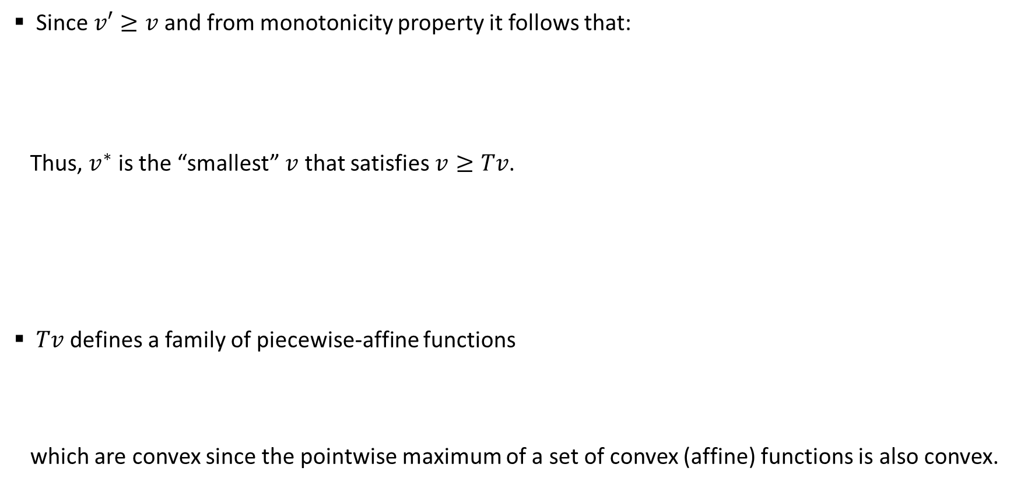
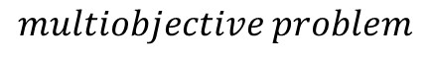
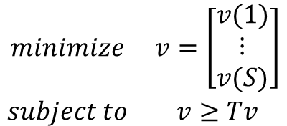
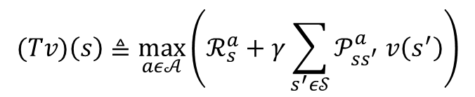
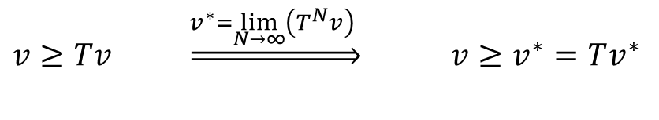
DP formulation as an LP (I)
Since$v′≥v$ and from monotonicity property it follows that:
Thus, $v^{∗}$ is the “smallest” $v$ that satisfies $v≥Tv$.
$Tv$ defines a family of piecewise-affine functions
which are convex since the pointwise maximum of a set of convex (affine) functions is also convex.
Optimal cost function condition
$v≥Tv \underset{⇒}{v^{∗}=\lim_{N→∞}\left(T^{N}v\right) }$ ${v≥v}^{∗}=Tv^{∗}$
$$\begin{matrix}minimize & v=\left[\begin{matrix}v(1) \\ \begin{matrix}⋮ \\ v(S)\end{matrix}\end{matrix}\right] \\ subject to & v≥Tv\end{matrix}$$
$$multiobjective problem$$
$$(Tv)\left(s\right)≜\max_{aε𝒜}\left(ℛ_{s}^{a}+γ\sum_{s^{′}ε𝒮}{𝒫_{ss^{′}}^{a} v\left(s^{′}\right)}\right)$$
Notes:
Multiobjective = vector optimization problem

Slide 9
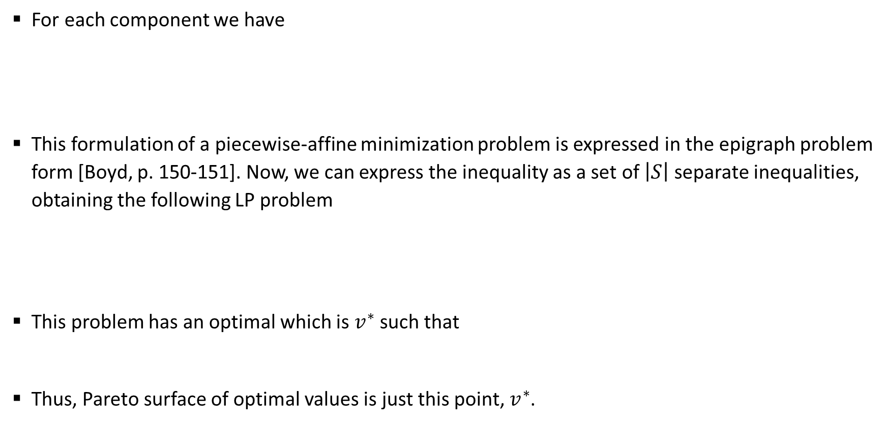
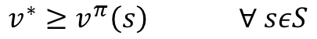
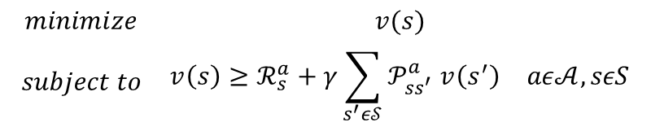
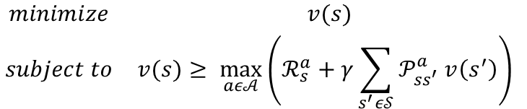
DP formulation as an LP (II)
For each component we have
This formulation of a piecewise-affine minimization problem is expressed in the epigraph problem form [Boyd, p. 150-151]. Now, we can express the inequality as a set of $\left|S\right|$ separate inequalities, obtaining the following LP problem
This problem has an optimal which is $v^{∗}$ such that
Thus, Pareto surface of optimal values is just this point, $v^{∗}$.
$$\begin{matrix}minimize & v(s) \\ subject to & v(s)≥\max_{aε𝒜}\left(ℛ_{s}^{a}+γ\sum_{s^{′}ε𝒮}{𝒫_{ss^{′}}^{a} v\left(s^{′}\right)}\right) \end{matrix}$$
$$\begin{matrix}minimize & v(s) \\ subject to & \begin{matrix}{v\left(s\right)≥ℛ}_{s}^{a}+γ\sum_{s^{′}ε𝒮}{𝒫_{ss^{′}}^{a} v\left(s^{′}\right)} & aε𝒜,sεS\end{matrix}\end{matrix}$$
$$v^{∗}≥v^{π}\left(s\right) ∀ sεS$$
Notes:
Multiobjective = vector optimization problem

Slide 10
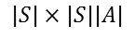
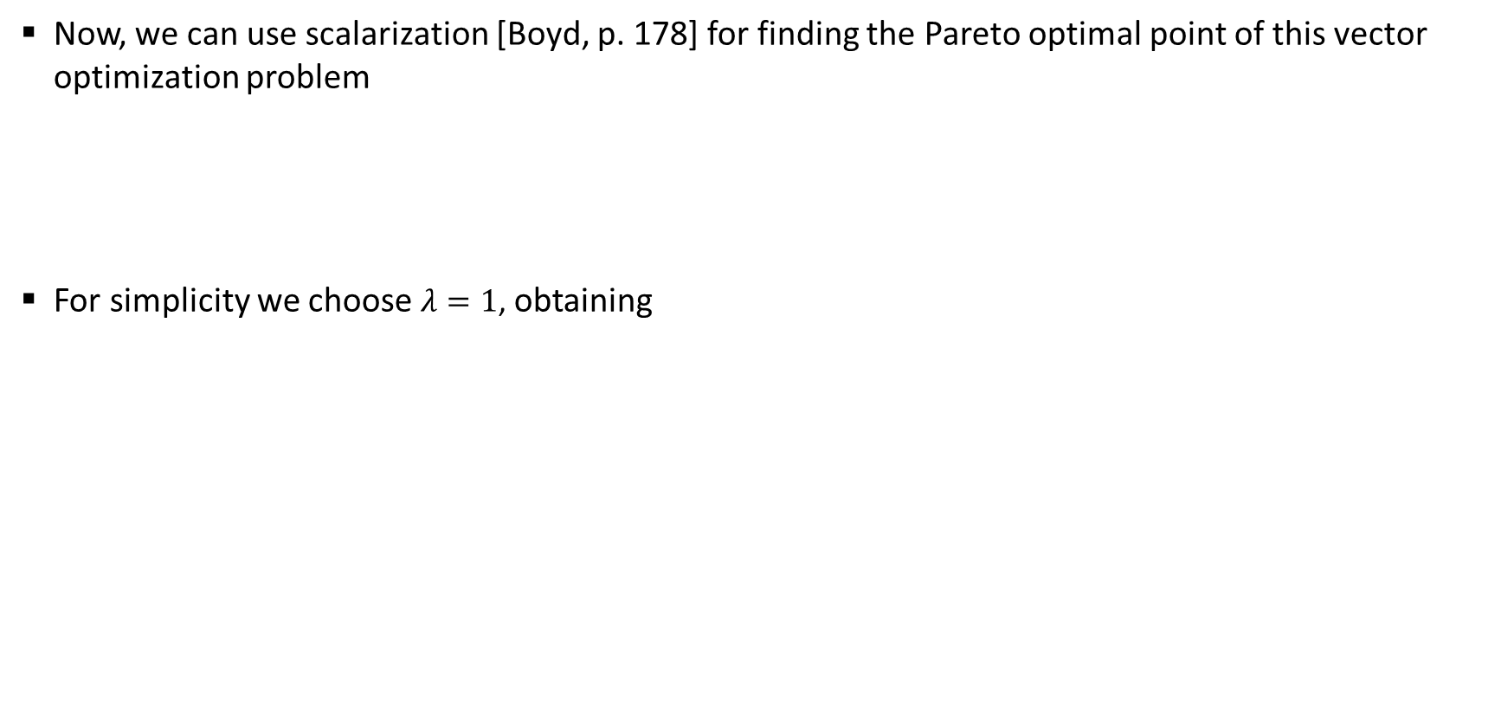
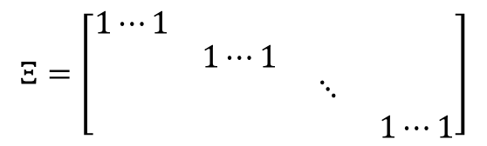

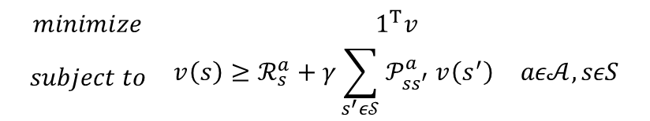
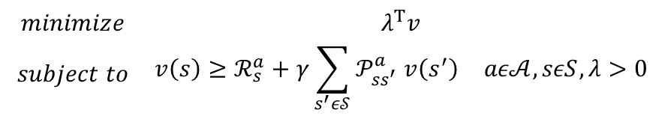
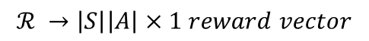
DP formulation as an LP (III)
Now, we can use scalarization [Boyd, p. 178] for finding the Pareto optimal point of this vector optimization problem
For simplicity we choose $λ=1$, obtaining
$$\begin{matrix}minimize & λ^{T}v \\ subject to & \begin{matrix}{v\left(s\right)≥ℛ}_{s}^{a}+γ\sum_{s^{′}ε𝒮}{𝒫_{ss^{′}}^{a} v\left(s^{′}\right)} & aε𝒜,sεS,λ>0\end{matrix}\end{matrix}$$
DP formulation as an LP
$$\begin{matrix}minimize & 1^{T}v \\ subject to & \begin{matrix}{v\left(s\right)≥ℛ}_{s}^{a}+γ\sum_{s^{′}ε𝒮}{𝒫_{ss^{′}}^{a} v\left(s^{′}\right)} & aε𝒜,sεS\end{matrix}\end{matrix}$$
vector form
$$\begin{matrix}minimize & 1^{T}v \\ subject to & Ξ^{T}v≥{ℛ+γ𝒫v} \end{matrix}$$
$$ℛ →\left|S\right|\left|A\right|×1 reward vector$$
$$Ξ=\left[\begin{matrix}1⋯1 & \begin{matrix}1⋯1 & 11 & 1⋯1\end{matrix} \\ \begin{matrix}1⋯1 \\ \begin{matrix}1⋯1 \\ 1⋯1\end{matrix}\end{matrix} & \begin{matrix}\begin{matrix}1⋯1 \\ \begin{matrix}1⋯1 \\ 1⋯1\end{matrix}\end{matrix} & \begin{matrix}\begin{matrix}11 & 1⋯1\end{matrix} \\ \begin{matrix}\begin{matrix}⋱ & 1⋯1\end{matrix} \\ \begin{matrix}11 & 1⋯1\end{matrix}\end{matrix}\end{matrix}\end{matrix}\end{matrix}\right]$$
$$𝒫 →\left|S\right|\left|A\right|×\left|S\right| transition matrix$$
$$|S|×|S||A|$$
$$v →\left|S\right|×1 state value function vector$$
Notes:
Multiobjective = vector optimization problem

Slide 11
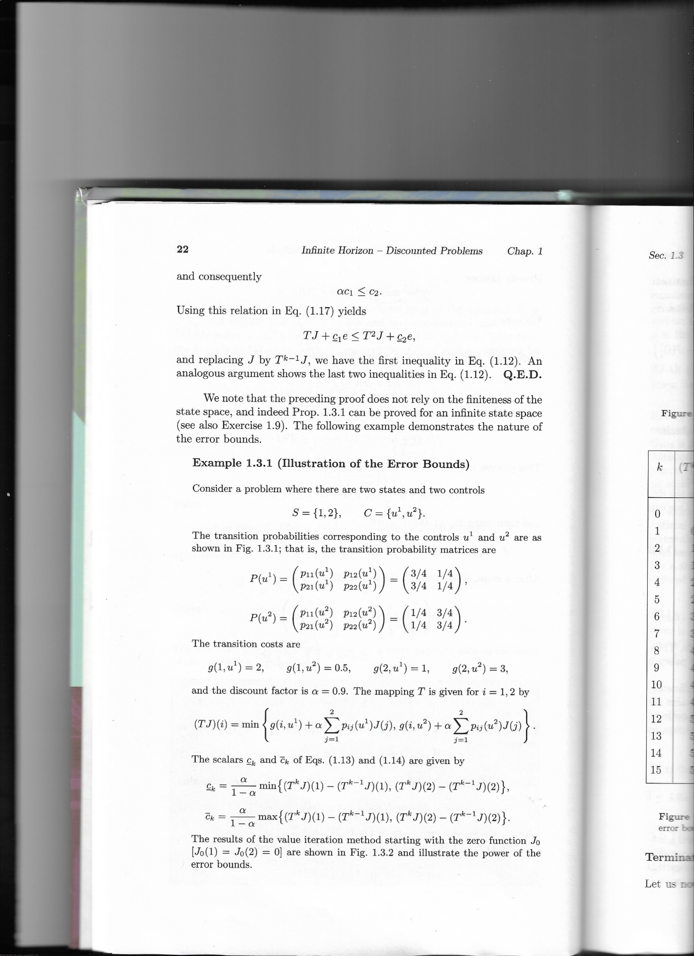

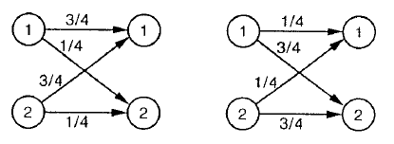
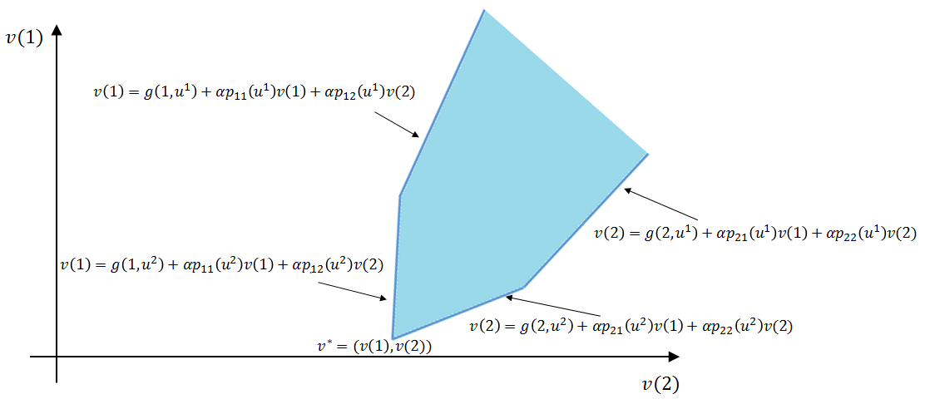
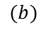
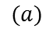
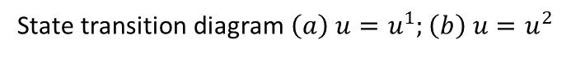
DP formulation as an LP (IV)
In order to summar
$$(a)$$
$$(b)$$
State transition diagram $\left(a\right) u=u^{1};\left(b\right) u=u^{2}$
Notes:
El state transition diagram muestra las transition probabilities corresponding to the controls u1 and u2

Slide 12
Content
Dynamic programming review
Dynamic programming as a linear programming problem
EXAMPLE (I): RANDOM WALK PROBLEM (DP VS LP CONVERGENCE)
Dual representation of the LP approach
Example (II): random walk problem (primal-dual comparison)
Future lines (09/03/2017)

Slide 13
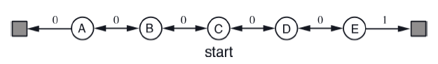
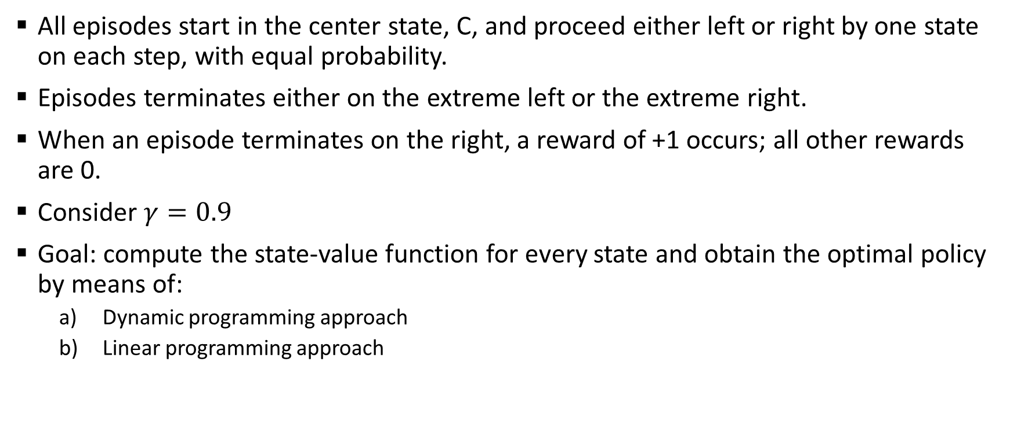
Example: random walk problem (I)
All episodes start in the center state, C, and proceed either left or right by one state on each step, with equal probability.
Episodes terminates either on the extreme left or the extreme right.
When an episode terminates on the right, a reward of +1 occurs; all other rewards are 0.
Consider $γ=0.9$
Goal: compute the state-value function for every state and obtain the optimal policy by means of:
Dynamic programming approach
Linear programming approach
T1
T2

Slide 14
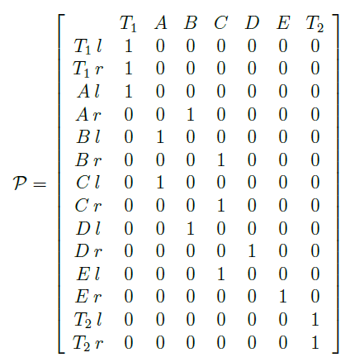
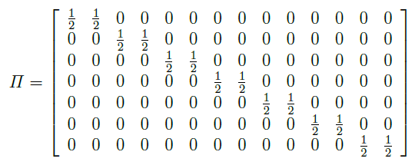
Example: random walk problem (II)
Reward vector (expected value of the reward for any transition from some state-action pair)
Transition probability matrix
Initial policy matrix
T1
T2

Slide 15
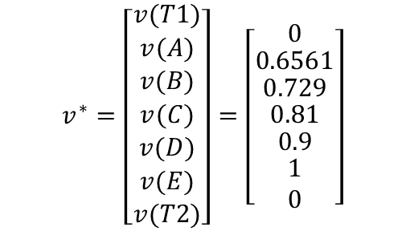
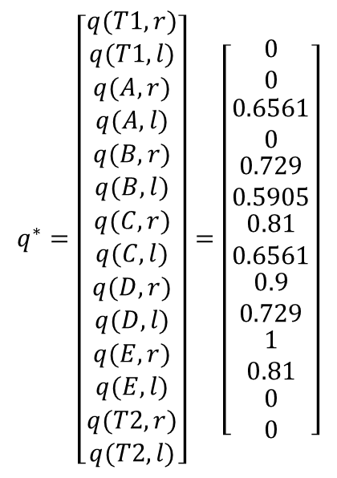
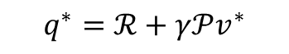
Example: random walk problem (DP) (I)
Solving the DP random walk problem by value iteration…
$$q^{∗}=\left[\begin{matrix}\begin{aligned}q(T1,r) \\ q(T1,l)\end{aligned} \\ \begin{matrix}\begin{aligned}q(A,r) \\ q(A,l)\end{aligned} \\ \begin{matrix}\begin{aligned}q(B,r) \\ q(B,l)\end{aligned} \\ \begin{matrix}\begin{aligned}q(C,r) \\ q(C,l)\end{aligned} \\ \begin{matrix}\begin{aligned}q(D,r) \\ q(D,l)\end{aligned} \\ \begin{matrix}\begin{aligned}q(E,r) \\ q(E,l)\end{aligned} \\ \begin{aligned}q(T2,r) \\ q(T2,l)\end{aligned}\end{matrix}\end{matrix}\end{matrix}\end{matrix}\end{matrix}\end{matrix}\right]=\left[\begin{matrix}\begin{aligned}0 \\ 0\end{aligned} \\ \begin{matrix}\begin{aligned}0.6561 \\ 0\end{aligned} \\ \begin{matrix}\begin{aligned}0.729 \\ 0.5905\end{aligned} \\ \begin{matrix}\begin{aligned}0.81 \\ 0.6561\end{aligned} \\ \begin{matrix}\begin{aligned}0.9 \\ 0.729\end{aligned} \\ \begin{matrix}\begin{aligned}1 \\ 0.81\end{aligned} \\ \begin{aligned}0 \\ 0\end{aligned}\end{matrix}\end{matrix}\end{matrix}\end{matrix}\end{matrix}\end{matrix}\right]$$
$$v^{∗}=\left[\begin{matrix}v(T1) \\ \begin{matrix}v(A) \\ \begin{matrix}v(B) \\ \begin{matrix}v(C) \\ \begin{matrix}v(D) \\ \begin{matrix}v(E) \\ v(T2)\end{matrix}\end{matrix}\end{matrix}\end{matrix}\end{matrix}\end{matrix}\right]=\left[\begin{matrix}0 \\ \begin{matrix}0.6561 \\ \begin{matrix}0.729 \\ \begin{matrix}0.81 \\ \begin{matrix}0.9 \\ \begin{matrix}1 \\ 0\end{matrix}\end{matrix}\end{matrix}\end{matrix}\end{matrix}\end{matrix}\right]$$
$$q^{∗}=ℛ+γ𝒫v^{∗}$$
T1
T2

Slide 16
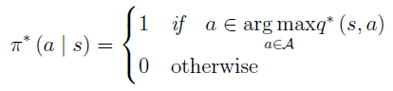
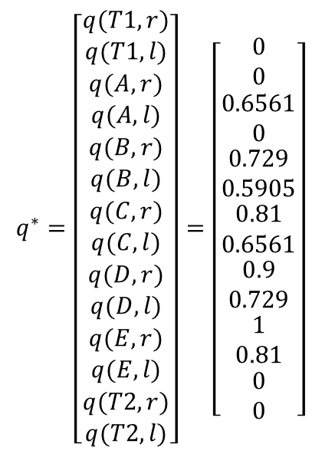
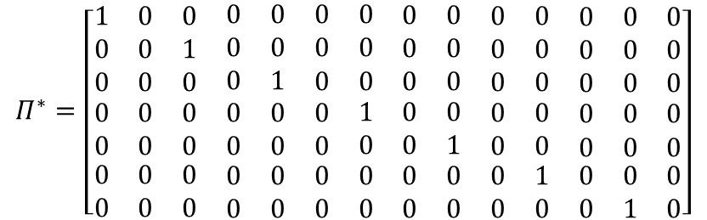
Example: random walk problem (DP) (II)
And the greedy policy associated with this problem…
$$q^{∗}=\left[\begin{matrix}\begin{aligned}q(T1,r) \\ q(T1,l)\end{aligned} \\ \begin{matrix}\begin{aligned}q(A,r) \\ q(A,l)\end{aligned} \\ \begin{matrix}\begin{aligned}q(B,r) \\ q(B,l)\end{aligned} \\ \begin{matrix}\begin{aligned}q(C,r) \\ q(C,l)\end{aligned} \\ \begin{matrix}\begin{aligned}q(D,r) \\ q(D,l)\end{aligned} \\ \begin{matrix}\begin{aligned}q(E,r) \\ q(E,l)\end{aligned} \\ \begin{aligned}q(T2,r) \\ q(T2,l)\end{aligned}\end{matrix}\end{matrix}\end{matrix}\end{matrix}\end{matrix}\end{matrix}\right]=\left[\begin{matrix}\begin{aligned}0 \\ 0\end{aligned} \\ \begin{matrix}\begin{aligned}0.6561 \\ 0\end{aligned} \\ \begin{matrix}\begin{aligned}0.729 \\ 0.5905\end{aligned} \\ \begin{matrix}\begin{aligned}0.81 \\ 0.6561\end{aligned} \\ \begin{matrix}\begin{aligned}0.9 \\ 0.729\end{aligned} \\ \begin{matrix}\begin{aligned}1 \\ 0.81\end{aligned} \\ \begin{aligned}0 \\ 0\end{aligned}\end{matrix}\end{matrix}\end{matrix}\end{matrix}\end{matrix}\end{matrix}\right]$$
$$Π^{∗}=\left[\begin{matrix}\begin{matrix}1 & 0 & 0 \\ 0 & 0 & 1 \\ 0 & 0 & 0\end{matrix} & \begin{matrix}0 & 0 & \begin{matrix}0 & 0 & \begin{matrix}0 & 0 & \begin{matrix}0 & 0 & \begin{matrix}0 & 0 & 0\end{matrix}\end{matrix}\end{matrix}\end{matrix} \\ 0 & 0 & \begin{matrix}0 & 0 & \begin{matrix}0 & 0 & \begin{matrix}0 & 0 & \begin{matrix}0 & 0 & 0\end{matrix}\end{matrix}\end{matrix}\end{matrix} \\ 0 & 1 & \begin{matrix}0 & 0 & \begin{matrix}0 & 0 & \begin{matrix}0 & 0 & \begin{matrix}0 & 0 & 0\end{matrix}\end{matrix}\end{matrix}\end{matrix}\end{matrix} \\ \begin{matrix}0 & 0 & 0 \\ 0 & 0 & 0 \\ \begin{matrix}0 \\ 0\end{matrix} & \begin{matrix}0 \\ 0\end{matrix} & \begin{matrix}0 \\ 0\end{matrix}\end{matrix} & \begin{matrix}\begin{matrix}0 & 0 & 0\end{matrix} & 1 & \begin{matrix}0 & 0 & \begin{matrix}0 & 0 & \begin{matrix}0 & 0 & 0\end{matrix}\end{matrix}\end{matrix} \\ \begin{matrix}0 & 0 & 0\end{matrix} & 0 & \begin{matrix}0 & 1 & \begin{matrix}0 & 0 & \begin{matrix}0 & 0 & 0\end{matrix}\end{matrix}\end{matrix} \\ \begin{matrix}\begin{matrix}0 \\ 0\end{matrix} & \begin{matrix}0 \\ 0\end{matrix} & \begin{matrix}0 \\ 0\end{matrix}\end{matrix} & \begin{matrix}0 \\ 0\end{matrix} & \begin{matrix}\begin{matrix}0 \\ 0\end{matrix} & \begin{matrix}0 \\ 0\end{matrix} & \begin{matrix}\begin{matrix}0 \\ 0\end{matrix} & \begin{matrix}1 \\ 0\end{matrix} & \begin{matrix}\begin{matrix}0 \\ 0\end{matrix} & \begin{matrix}0 \\ 1\end{matrix} & \begin{matrix}0 \\ 0\end{matrix}\end{matrix}\end{matrix}\end{matrix}\end{matrix}\end{matrix}\right]$$
T1
T2

Slide 17
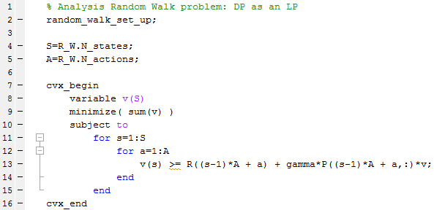






Example: random walk problem (LP)
Solving the LP random walk problem by CVX...
$$q^{∗}=\left[\begin{matrix}\begin{aligned}q(T1,r) \\ q(T1,l)\end{aligned} \\ \begin{matrix}\begin{aligned}q(A,r) \\ q(A,l)\end{aligned} \\ \begin{matrix}\begin{aligned}q(B,r) \\ q(B,l)\end{aligned} \\ \begin{matrix}\begin{aligned}q(C,r) \\ q(C,l)\end{aligned} \\ \begin{matrix}\begin{aligned}q(D,r) \\ q(D,l)\end{aligned} \\ \begin{matrix}\begin{aligned}q(E,r) \\ q(E,l)\end{aligned} \\ \begin{aligned}q(T2,r) \\ q(T2,l)\end{aligned}\end{matrix}\end{matrix}\end{matrix}\end{matrix}\end{matrix}\end{matrix}\right]=\left[\begin{matrix}\begin{aligned}0 \\ 0\end{aligned} \\ \begin{matrix}\begin{aligned}0.6561 \\ 0\end{aligned} \\ \begin{matrix}\begin{aligned}0.729 \\ 0.5905\end{aligned} \\ \begin{matrix}\begin{aligned}0.81 \\ 0.6561\end{aligned} \\ \begin{matrix}\begin{aligned}0.9 \\ 0.729\end{aligned} \\ \begin{matrix}\begin{aligned}1 \\ 0.81\end{aligned} \\ \begin{aligned}0 \\ 0\end{aligned}\end{matrix}\end{matrix}\end{matrix}\end{matrix}\end{matrix}\end{matrix}\right]$$
$$v^{∗}=\left[\begin{matrix}v(T1) \\ \begin{matrix}v(A) \\ \begin{matrix}v(B) \\ \begin{matrix}v(C) \\ \begin{matrix}v(D) \\ \begin{matrix}v(E) \\ v(T2)\end{matrix}\end{matrix}\end{matrix}\end{matrix}\end{matrix}\end{matrix}\right]=\left[\begin{matrix}0 \\ \begin{matrix}0.6561 \\ \begin{matrix}0.729 \\ \begin{matrix}0.81 \\ \begin{matrix}0.9 \\ \begin{matrix}1 \\ 0\end{matrix}\end{matrix}\end{matrix}\end{matrix}\end{matrix}\end{matrix}\right]$$
$$Π^{∗}=\left[\begin{matrix}\begin{matrix}1 & 0 & 0 \\ 0 & 0 & 1 \\ 0 & 0 & 0\end{matrix} & \begin{matrix}0 & 0 & \begin{matrix}0 & 0 & \begin{matrix}0 & 0 & \begin{matrix}0 & 0 & \begin{matrix}0 & 0 & 0\end{matrix}\end{matrix}\end{matrix}\end{matrix} \\ 0 & 0 & \begin{matrix}0 & 0 & \begin{matrix}0 & 0 & \begin{matrix}0 & 0 & \begin{matrix}0 & 0 & 0\end{matrix}\end{matrix}\end{matrix}\end{matrix} \\ 0 & 1 & \begin{matrix}0 & 0 & \begin{matrix}0 & 0 & \begin{matrix}0 & 0 & \begin{matrix}0 & 0 & 0\end{matrix}\end{matrix}\end{matrix}\end{matrix}\end{matrix} \\ \begin{matrix}0 & 0 & 0 \\ 0 & 0 & 0 \\ \begin{matrix}0 \\ 0\end{matrix} & \begin{matrix}0 \\ 0\end{matrix} & \begin{matrix}0 \\ 0\end{matrix}\end{matrix} & \begin{matrix}\begin{matrix}0 & 0 & 0\end{matrix} & 1 & \begin{matrix}0 & 0 & \begin{matrix}0 & 0 & \begin{matrix}0 & 0 & 0\end{matrix}\end{matrix}\end{matrix} \\ \begin{matrix}0 & 0 & 0\end{matrix} & 0 & \begin{matrix}0 & 1 & \begin{matrix}0 & 0 & \begin{matrix}0 & 0 & 0\end{matrix}\end{matrix}\end{matrix} \\ \begin{matrix}\begin{matrix}0 \\ 0\end{matrix} & \begin{matrix}0 \\ 0\end{matrix} & \begin{matrix}0 \\ 0\end{matrix}\end{matrix} & \begin{matrix}0 \\ 0\end{matrix} & \begin{matrix}\begin{matrix}0 \\ 0\end{matrix} & \begin{matrix}0 \\ 0\end{matrix} & \begin{matrix}\begin{matrix}0 \\ 0\end{matrix} & \begin{matrix}1 \\ 0\end{matrix} & \begin{matrix}\begin{matrix}0 \\ 0\end{matrix} & \begin{matrix}0 \\ 1\end{matrix} & \begin{matrix}0 \\ 0\end{matrix}\end{matrix}\end{matrix}\end{matrix}\end{matrix}\end{matrix}\right]$$
$$\left\|v_{DP}^{∗}−v_{LP}^{∗}\right\|=0$$
$$\left\|q_{DP}^{∗}−q_{LP}^{∗}\right\|=0$$
$$\left\|Π_{DP}^{∗}−Π_{LP}^{∗}\right\|=0$$

Slide 18
Content
Dynamic programming review
Dynamic programming as a linear programming problem
Example (I): random walk problem (DP vs LP convergence)
DUAL REPRESENTATION OF THE LP APPROACH
Example (II): random walk problem (primal-dual comparison)
Future lines (09/03/2017)

Slide 19


Dual representation of the LP approach (I)
Dual representation allow us to obtain
A formulation independent of the value function
A problem which is always concave (Lagrange dual function [Boyd, p. 216])
Dual updates usually¹ converge where primal updates can and often do diverge.
Instead of minimizing $1^{T}v$, let us minimize $\left(1−γ\right) μ^{T}v$ over $v$, where $0<γ<1$ and $μ$ is a vector $|S|×1$ of probability distribution over the initial state ($μ>0$ and $1^{T}μ=1$).
The Lagrangian of this primal problem, with dual variable $d≥0, d ε ℝ^{\left|S\right|\left|A\right|},$ is given by
$$\begin{matrix}minimize & \left(1−γ\right) μ^{T}v \\ subject to & Ξ^{T}v≥{ℛ+γ𝒫v}\end{matrix}$$
$$L\left(v,d\right)=\left(1−γ\right) μ^{T}v+d^{T}(ℛ+γ𝒫v−Ξ^{T}v)$$
¹Except in the case of gradient-based off-policy updates with linear function approximation

Slide 20



Dual representation of the LP approach (II)
The Lagrange dual function is defined as
The first order condition for minimizing the Lagrangian over the primal variable v is given by
Hence,
Therefore, the dual problem is given by
$$g\left(d\right)=\inf_{v{εℝ}^{\left|S\right|}}{ L\left(v,d\right)}$$
$$∇_{v}L\left(v,d\right)=\left(1−γ\right)μ+γ𝒫^{T}d−Ξd=0$$
$$g\left(d\right)=\left\{\begin{aligned}\begin{matrix}d^{T}ℛ & if Ξd=\left(1−γ\right)μ+γ𝒫^{T}d\end{matrix} \\ \begin{matrix}−∞ & otherwise \end{matrix}\end{aligned}\right.$$
$$\begin{matrix}\underset{d}{maximize} & d^{T}ℛ \\ \begin{aligned}subject to \\ \end{aligned} & \begin{matrix}Ξd=\left(1−γ\right)μ+γ𝒫^{T}d \\ d≥0\end{matrix}\end{matrix}$$

Slide 21




Why using dual representation? (I)
Let $v^{∗}$denote the solution to the primal problem, and $d^{∗}$ the solution to the dual one. By strong duality, we know that the optimal objective value of the dual equals the optimal objective value of the primal
Before unrolling the left side of previous equality, we introduce the optimal discounted stationary distributions over states conditioned on the initial state $x$
Now, by using the following relationship that can be found in [Sutton, p. 3]
we can proceed to unroll the previous strong duality equality.
$$\left(1−γ\right) μ^{T}v^{∗}=d^{∗^{T}}ℛ$$
Notes:
Nos hemos quitado la dependencia de la value function y vamo a ver que se puede recuperar la polítcia a partir de d

Slide 22







Why using dual representation? (II)
Unrolling the left side of $\left(1−γ\right) μ^{T}v^{∗}=d^{∗^{T}}ℛ$:
where
Unrolling the right side of $\left(1−γ\right) μ^{T}v^{∗}=d^{∗^{T}}ℛ$:
where
We know that $d^{∗}≥0$ and [Wang, p. 4] shows that ${1^{T}d}^{∗}=1$
We can see $d^{∗}$ as a joint probability distribution over state-action pairs, been $h^{∗}$ and $φ^{∗}$ also probability distributions.

Slide 23


Why using dual representation? (III)
Using the two unrolls and the strong duality condition, we have
We conclude that we can obtain the optimal policy from the optimal dual variable
$$π^{∗}\left(a | s\right)=π^{∗}\left(s,a\right)=φ^{∗}\left(s,a\right)=\frac{d^{∗}\left(s,a\right)}{\sum_{aε𝒜}{d^{∗}\left(s,a\right)}}$$
While the primal linear problem searches the optimal value, the dual formulation searches in the policy space

Slide 24
Content
Dynamic programming review
Dynamic programming as a linear programming problem
Example (I): random walk problem (DP vs LP convergence)
Dual representation of the LP approach
EXAMPLE (II): RANDOM WALK PROBLEM (PRIMAL-DUAL COMPARISON)
Future lines (09/03/2017)

Slide 25




Example: random walk problem (I)
a
ATTENTION: ¿depends on chosen µ?
$$π^{∗}\left(a | s\right)=\frac{d^{∗}\left(s,a\right)}{\sum_{aε𝒜}{d^{∗}\left(s,a\right)}}$$
a1 = right
a2 = left

Slide 26








Example: random walk problem (II)
a
$${Π_{LP}^{∗}}^{PRIMAL}=\left[\begin{matrix}\begin{matrix}1 & 0 & 0 \\ 0 & 0 & 1 \\ 0 & 0 & 0\end{matrix} & \begin{matrix}0 & 0 & \begin{matrix}0 & 0 & \begin{matrix}0 & 0 & \begin{matrix}0 & 0 & \begin{matrix}0 & 0 & 0\end{matrix}\end{matrix}\end{matrix}\end{matrix} \\ 0 & 0 & \begin{matrix}0 & 0 & \begin{matrix}0 & 0 & \begin{matrix}0 & 0 & \begin{matrix}0 & 0 & 0\end{matrix}\end{matrix}\end{matrix}\end{matrix} \\ 0 & 1 & \begin{matrix}0 & 0 & \begin{matrix}0 & 0 & \begin{matrix}0 & 0 & \begin{matrix}0 & 0 & 0\end{matrix}\end{matrix}\end{matrix}\end{matrix}\end{matrix} \\ \begin{matrix}0 & 0 & 0 \\ 0 & 0 & 0 \\ \begin{matrix}0 \\ 0\end{matrix} & \begin{matrix}0 \\ 0\end{matrix} & \begin{matrix}0 \\ 0\end{matrix}\end{matrix} & \begin{matrix}\begin{matrix}0 & 0 & 0\end{matrix} & 1 & \begin{matrix}0 & 0 & \begin{matrix}0 & 0 & \begin{matrix}0 & 0 & 0\end{matrix}\end{matrix}\end{matrix} \\ \begin{matrix}0 & 0 & 0\end{matrix} & 0 & \begin{matrix}0 & 1 & \begin{matrix}0 & 0 & \begin{matrix}0 & 0 & 0\end{matrix}\end{matrix}\end{matrix} \\ \begin{matrix}\begin{matrix}0 \\ 0\end{matrix} & \begin{matrix}0 \\ 0\end{matrix} & \begin{matrix}0 \\ 0\end{matrix}\end{matrix} & \begin{matrix}0 \\ 0\end{matrix} & \begin{matrix}\begin{matrix}0 \\ 0\end{matrix} & \begin{matrix}0 \\ 0\end{matrix} & \begin{matrix}\begin{matrix}0 \\ 0\end{matrix} & \begin{matrix}1 \\ 0\end{matrix} & \begin{matrix}\begin{matrix}0 \\ 0\end{matrix} & \begin{matrix}0 \\ 1\end{matrix} & \begin{matrix}0 \\ 0\end{matrix}\end{matrix}\end{matrix}\end{matrix}\end{matrix}\end{matrix}\right]$$
$μ=\frac{1}{|S|}$ for each state
$${Π_{LP}^{∗}}^{DUAL}=$$
always starting at state C
(deterministic initial distribution)
$${Π_{LP}^{∗}}^{DUAL}=$$
(uniform initial distribution)
¿¿¿ DEPENDENCY ON $μ$ ???
Ans: No…

Slide 27







Example: random walk problem (III)
a
$μ=\frac{1}{|S|}$ for each state
$${Π_{LP}^{∗}}^{DUAL}=$$
always starting at state C
(deterministic initial distribution)
$${Π_{LP}^{∗}}^{DUAL}=$$
(uniform initial distribution)
¿¿¿ DEPENDENCY ON $μ$ ???
No, we were just violating scalarization condition when assuming $μ(s)=0$ for every state $s≠C$.
If we now define $μ$ as
$μ^{T}=\left[\frac{0.01}{6} \frac{0.01}{6} \frac{0.01}{6} 0.99 \frac{0.01}{6} \frac{0.01}{6}\right]$
the policy obtained is the desired

Slide 28
Content
Dynamic programming review
Dynamic programming as a linear programming problem
Example (I): random walk problem (DP vs LP convergence)
Dual representation of the LP approach
Example (II): random walk problem (primal-dual comparison)
FUTURE LINES (09/03/2017)

Slide 29

Future lines (09/03/2017)
The milestones for next meeting are…(close presentation view)

